Slide 1







ROG: A High Performance and Robust Distributed Training System for Robotic IoT
ChinaSys 22’ & MICRO 22’
Xiuxian Guan, Zekai Sun, Shengliang Deng, Xusheng Chen,
Shixiong Zhao, Zongyuan Zhang, Tianyang Duan, Yuexuan Wang, Chenshu Wu, Yong Cui, Libo Zhang, Yanjun Wu, Rui Wang, Heming Cui
The University of Hong Kong
Tsinghua University
Institute of Software, Chinese Academy of Science
Southern University of Science and Technology
Notes:
Hello, everyone. I’m zekai sun, a third year PhD student co supervised by Professor Cui Heming from The University of Hong Kong We are more than happy to share our paper that appeared in this year’s MICRO, which is titled, ROG A High Performance and Robust Distributed Training System for Robotic IoT.

Slide 2
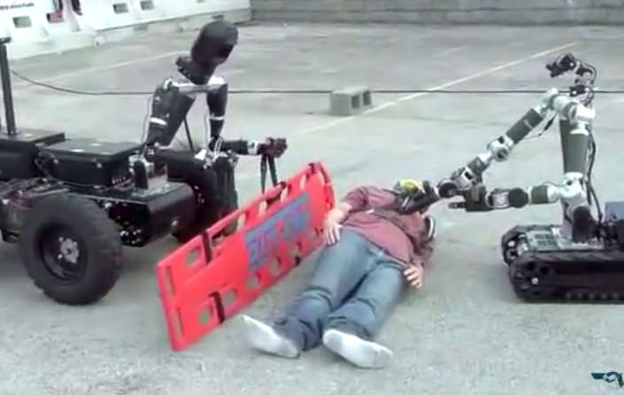
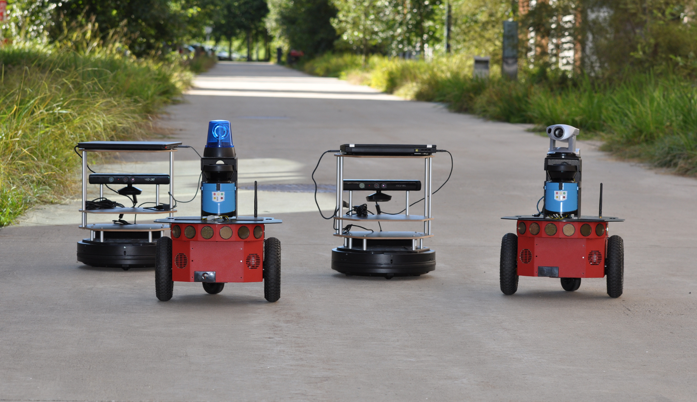
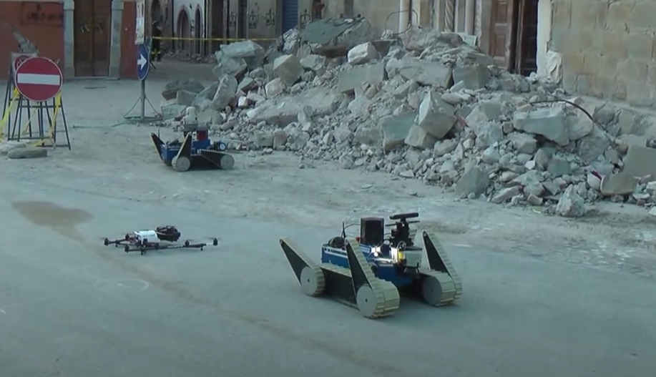
Motivation
Intelligent robotic tasks cooperatively deployed over a robot team to leverage limited computation resource on robots.
Machine learning (ML) models in complex environments.
e.g., objective recognition models, action control models
ML models typically require real-time training to adapt to changing environments.
e.g., from sunny to foggy
Robots in the field lack stable Internet access to a cloud data center.
The robots connect via the Internet of Things of robots (robotic IoT networks), which are wireless.
Cooperative robotic tasks require distributed training among the robot team via the robotic IoT networks to accelerate the real-time training.
rescue
disaster response
field exploration
Notes:
Nowadays, many intelligent robotic tasks such as rescue and disaster response involve recognition or action control with machine learning models, and they are typically cooperatively deployed over a team of robots to leverage the limited computation resources on robots.
Since the models cannot be pretrained against every possible situations, such ML models often require real-time training to adapt to changing environments.
However, robots in the filed lack stable internet access to a cloud data center and could only communicate with other robots via the robotic IoT networks.
This motivates distributed training among the robot team via the robotic IoT to accelerate the real-time training.

Slide 3
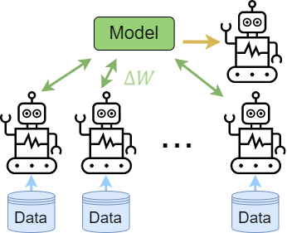

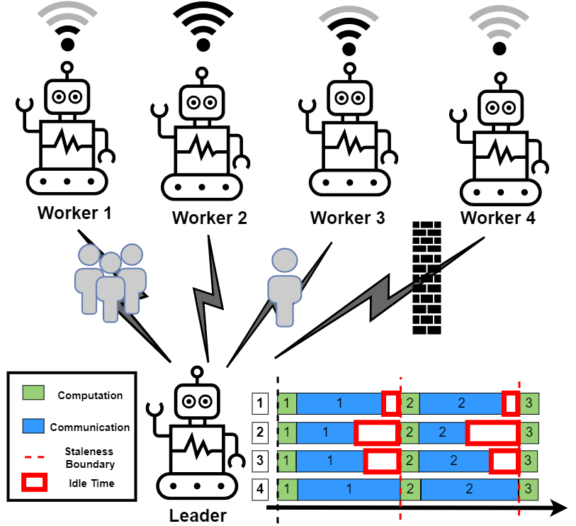
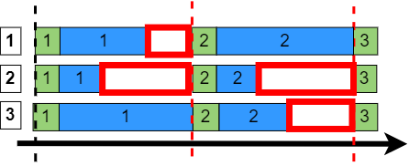
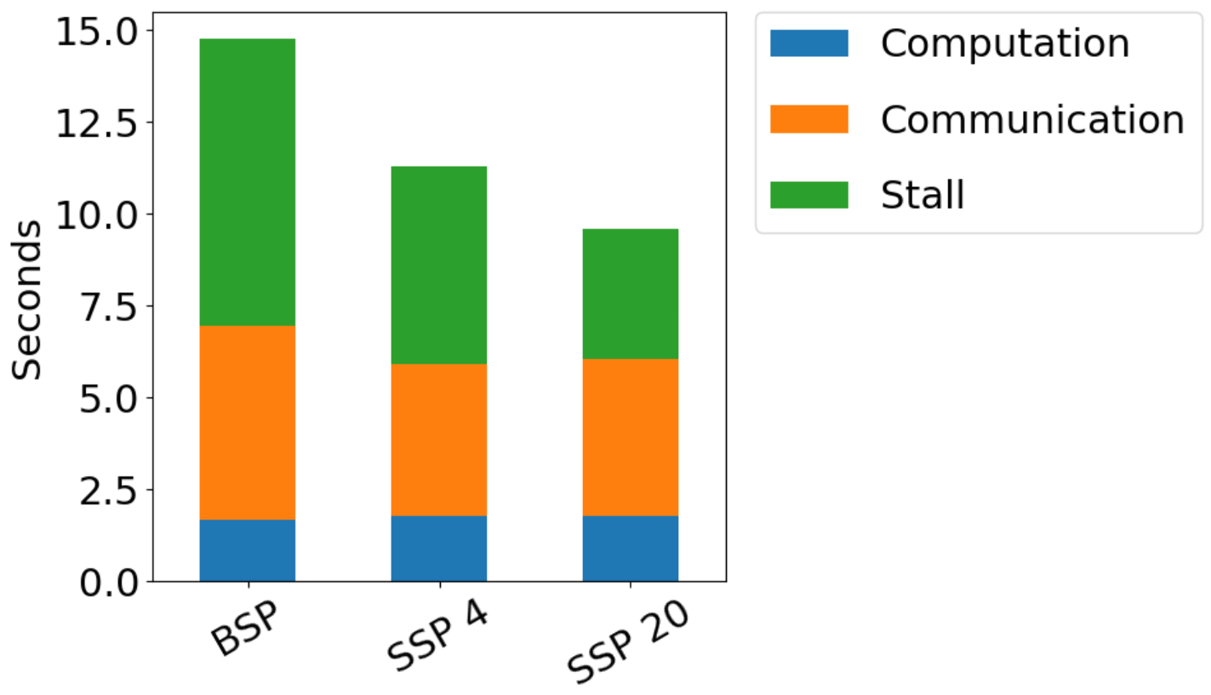
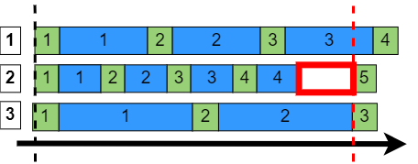
Existing Distributed Training over Robotic IoT
They typically adopt the parameter server paradigm.
Gradient Compression.
Lossy gradient compression methods
e.g., DGC (ICLR’18), TopK
No convergence guarantee
Lossless compression methods
e.g., one-bit (NIPS’19)
The communication time is still comparable to the computation time.
Bulk Synchronous Parallel (BSP)
Stale Synchronous Parallel (SSP)
Threshold =2
Notes:
All reduce
Gradient compression

Slide 4

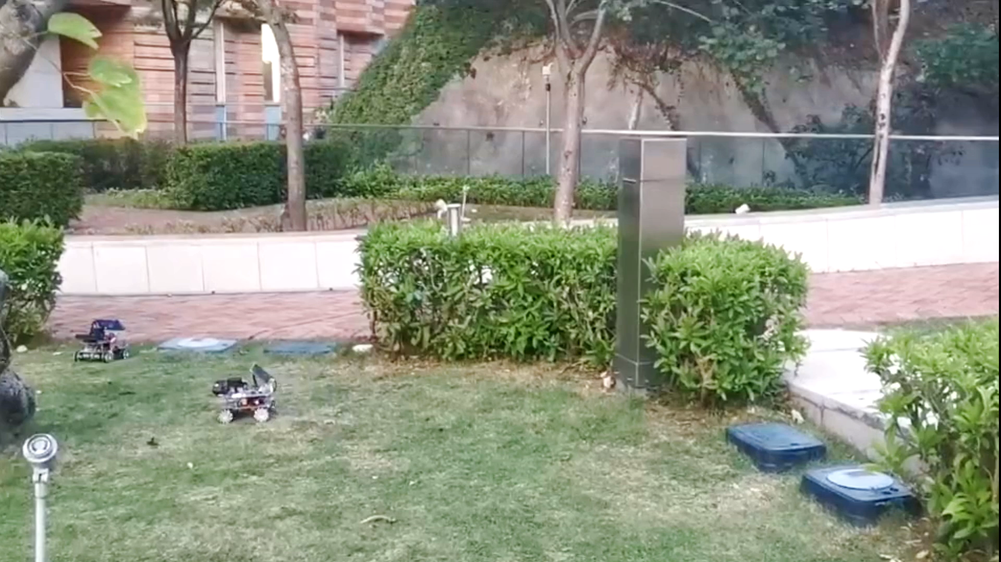
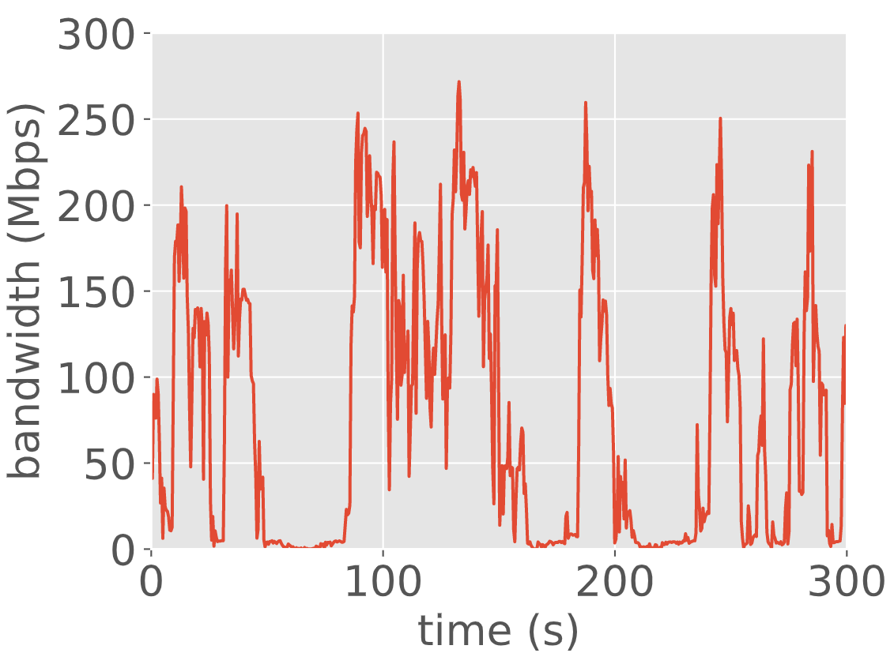
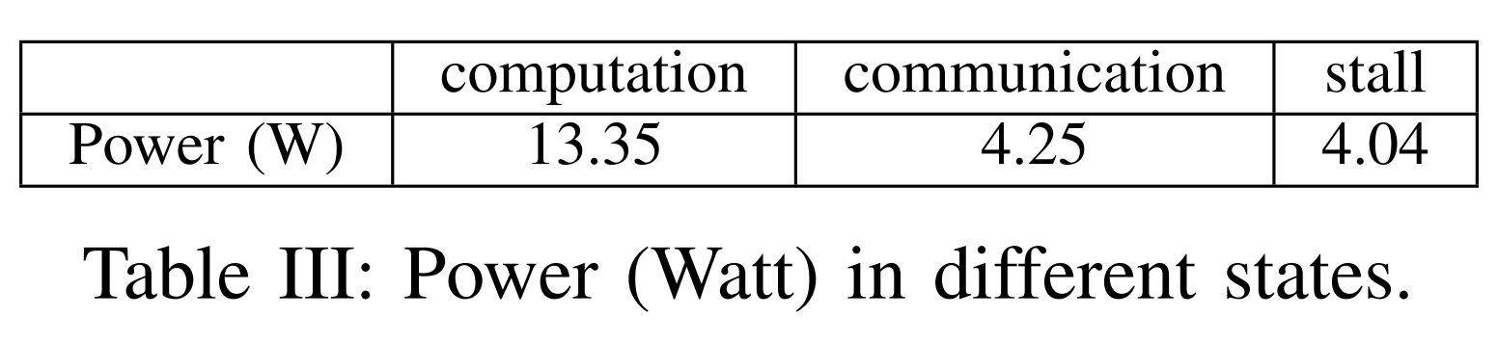
Problems of Distributed Training over Robotic IoT
Bandwidth capacity of Robotic IoT networks (e.g., Wi-Fi, 5G, WiMAX) is typically unstable.
Random, frequent and sharp degradation
Movement of the devices; occlusion from obstacles (e.g., crowds, walls)
Straggler effect in distributed training in robotic IoT
Periodic synchronizations are required (e.g., BSP).
Unbalanced bandwidth capacity causes frequent stall (e.g., stall for 50% time of the training time), lowering training throughput (i.e., number of training iterations per unit time).
Stall significantly wastes energy (e.g., 35%).
Real-time bandwidth capacity on Worker 4
Notes:
However, the paradigm of distributed training over robotic IoT faces the following problem.
Since the robotic IoT is essentially a wireless network, it has unstable bandwidth capacity. (We refer to bandwidth capacity as the maximal data volume transmitted per unit time.) The chart below records the bandwidth capacity of a robot moving in our campus garden. With the movement of the robots that changes the communication distances and occlusion from obstacles like bushes, the bandwidth capacity encounters random, frequent and sharp degradations.
This leads to the straggler effect in distributed training.
First, distributed training requires periodic synchronization of model updates to aggregate the learned knowledge. Such as BSP that requires total synchronization from all workers after each training iteration.
The unstable bandwidth leads to unbalanced transmission time among robots. As shown in the red rectangle in the right chart, the robots that finish synchronizing model updates have to wait or stall for stragglers to transmit in severely degraded bandwidth. Stall lowers the training throughput, which means the number of training iterations per unit time.
What’s more, we recorded the power consumption of robots in different states in the table; and the power consumption when a robot is stalling takes up 35% of the power consumption when the robot is computing, which is non-negligible. As a result, the longer a robot stalls, the more energy wasted.

Slide 5
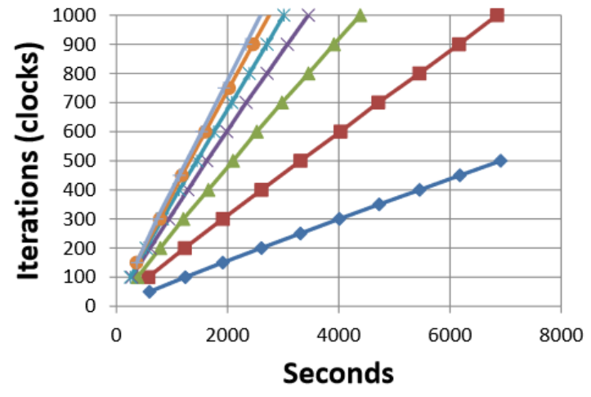
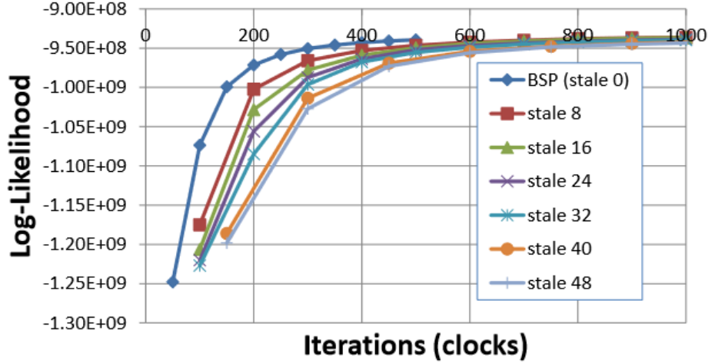
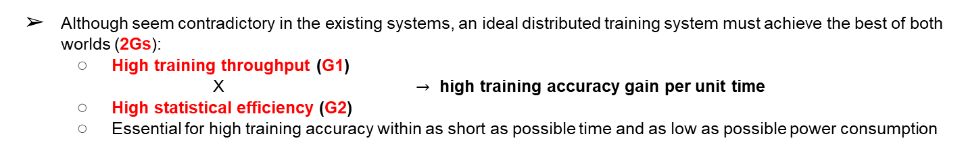
Rethinking Distributed Training for Robotic IoT
Existing distributed training paradigms fall short in handling straggler effect.
Stale Synchronous Parallel (SSP [NIPS’13]): tolerate staled model updates from others within a threshold
Low staleness threshold fails to mitigate straggler effect (low training throughput)
High staleness threshold downgrades the statistical efficiency.
i.e., the training accuracy gain per training iteration
Training Throughput [1]
Statistical Efficiency [1]
Scheduling-based SSP (e.g., FLOWN [TWC ‘21]): schedule to balance throughput and statistical efficiency
The pre-scheduled transmission mismatches with the actual fluctuating bandwidth, downgrading the training throughput.
Although seem contradictory in the existing systems, an ideal distributed training system must achieve the best of both worlds (2Gs):
High training throughput (G1)
X $→$ high training accuracy gain per unit time
High statistical efficiency (G2)
Essential for high training accuracy within as short as possible time and as low as possible power consumption
[1] Q. Ho, et.al, “More effective distributed ML via a stale synchronous parallel parameter server,” in Advances in Neural Information Processing Systems, vol. 26, 2013.
Notes:
Unfortunately, the existing distributed training paradigms fall short in handling the straggler effect.
For example, SSP loosens the synchronization requirements and tolerates staled model updates from other workers within a threshold. But it faces a dilemma in selecting the staleness threshold.
While low staleness thresholds, such as the blue and red dotted line in the left chart, fails to mitigate the straggler effect and leads to low training throughput,
high staleness thresholds, such as the gray dotted line in the right chart,
achieves high training throughput at the cost of low statistical efficiency. Statistical efficiency means the training accuracy gain per training iteration.
As another example, Scheduling-based SSP tries to balance training throughput and statistical efficiency with scheduling.
But unfortunately, the pre-scheduled transmission of the model updates often mismatches with the actual fluctuating bandwidth, downgrading the training throughput.
Training throughput and statistical efficiency seem contradictory in the existing systems, but nevertheless, an ideal distributed training system must achieve the best of both worlds, which are the two goals of high training throughput and high statistical efficiency. Because high training accuracy gain per unit time is intuitively the multiplication of high training throughput and high statistical efficiency, and is essential for high training accuracy within as short as possible time and as low as possible power consumption.

Slide 6
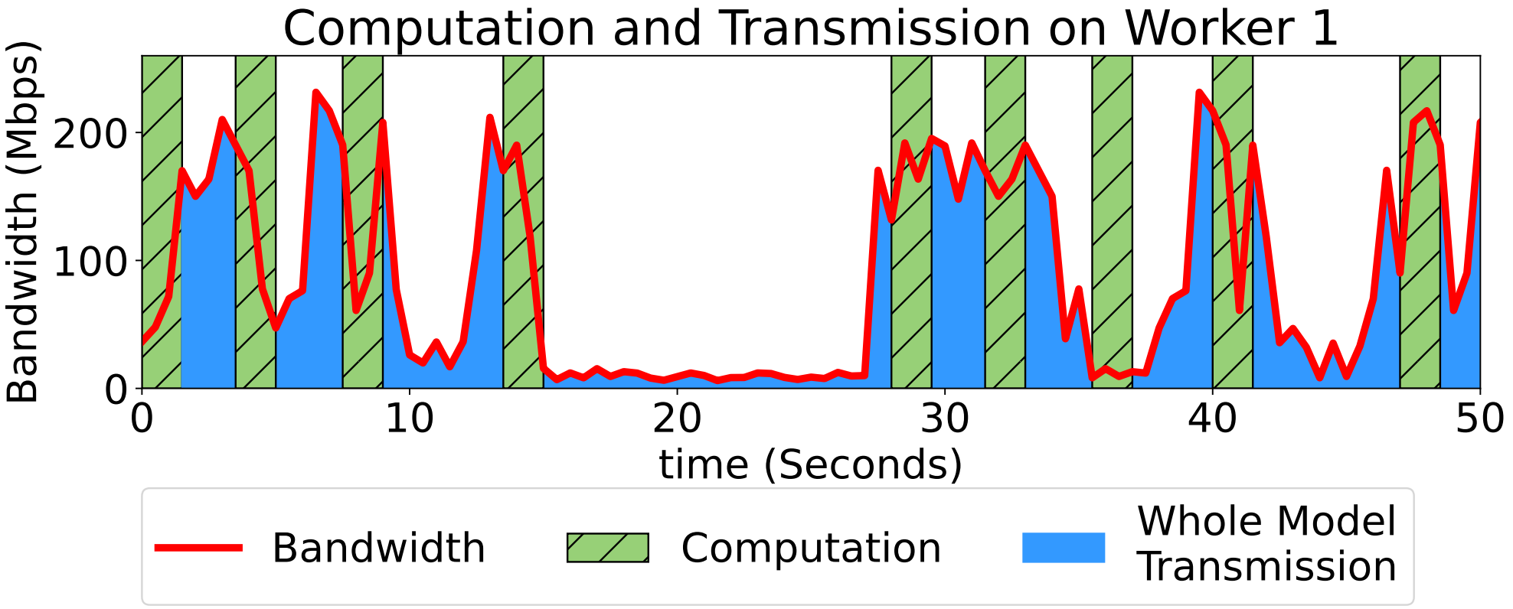
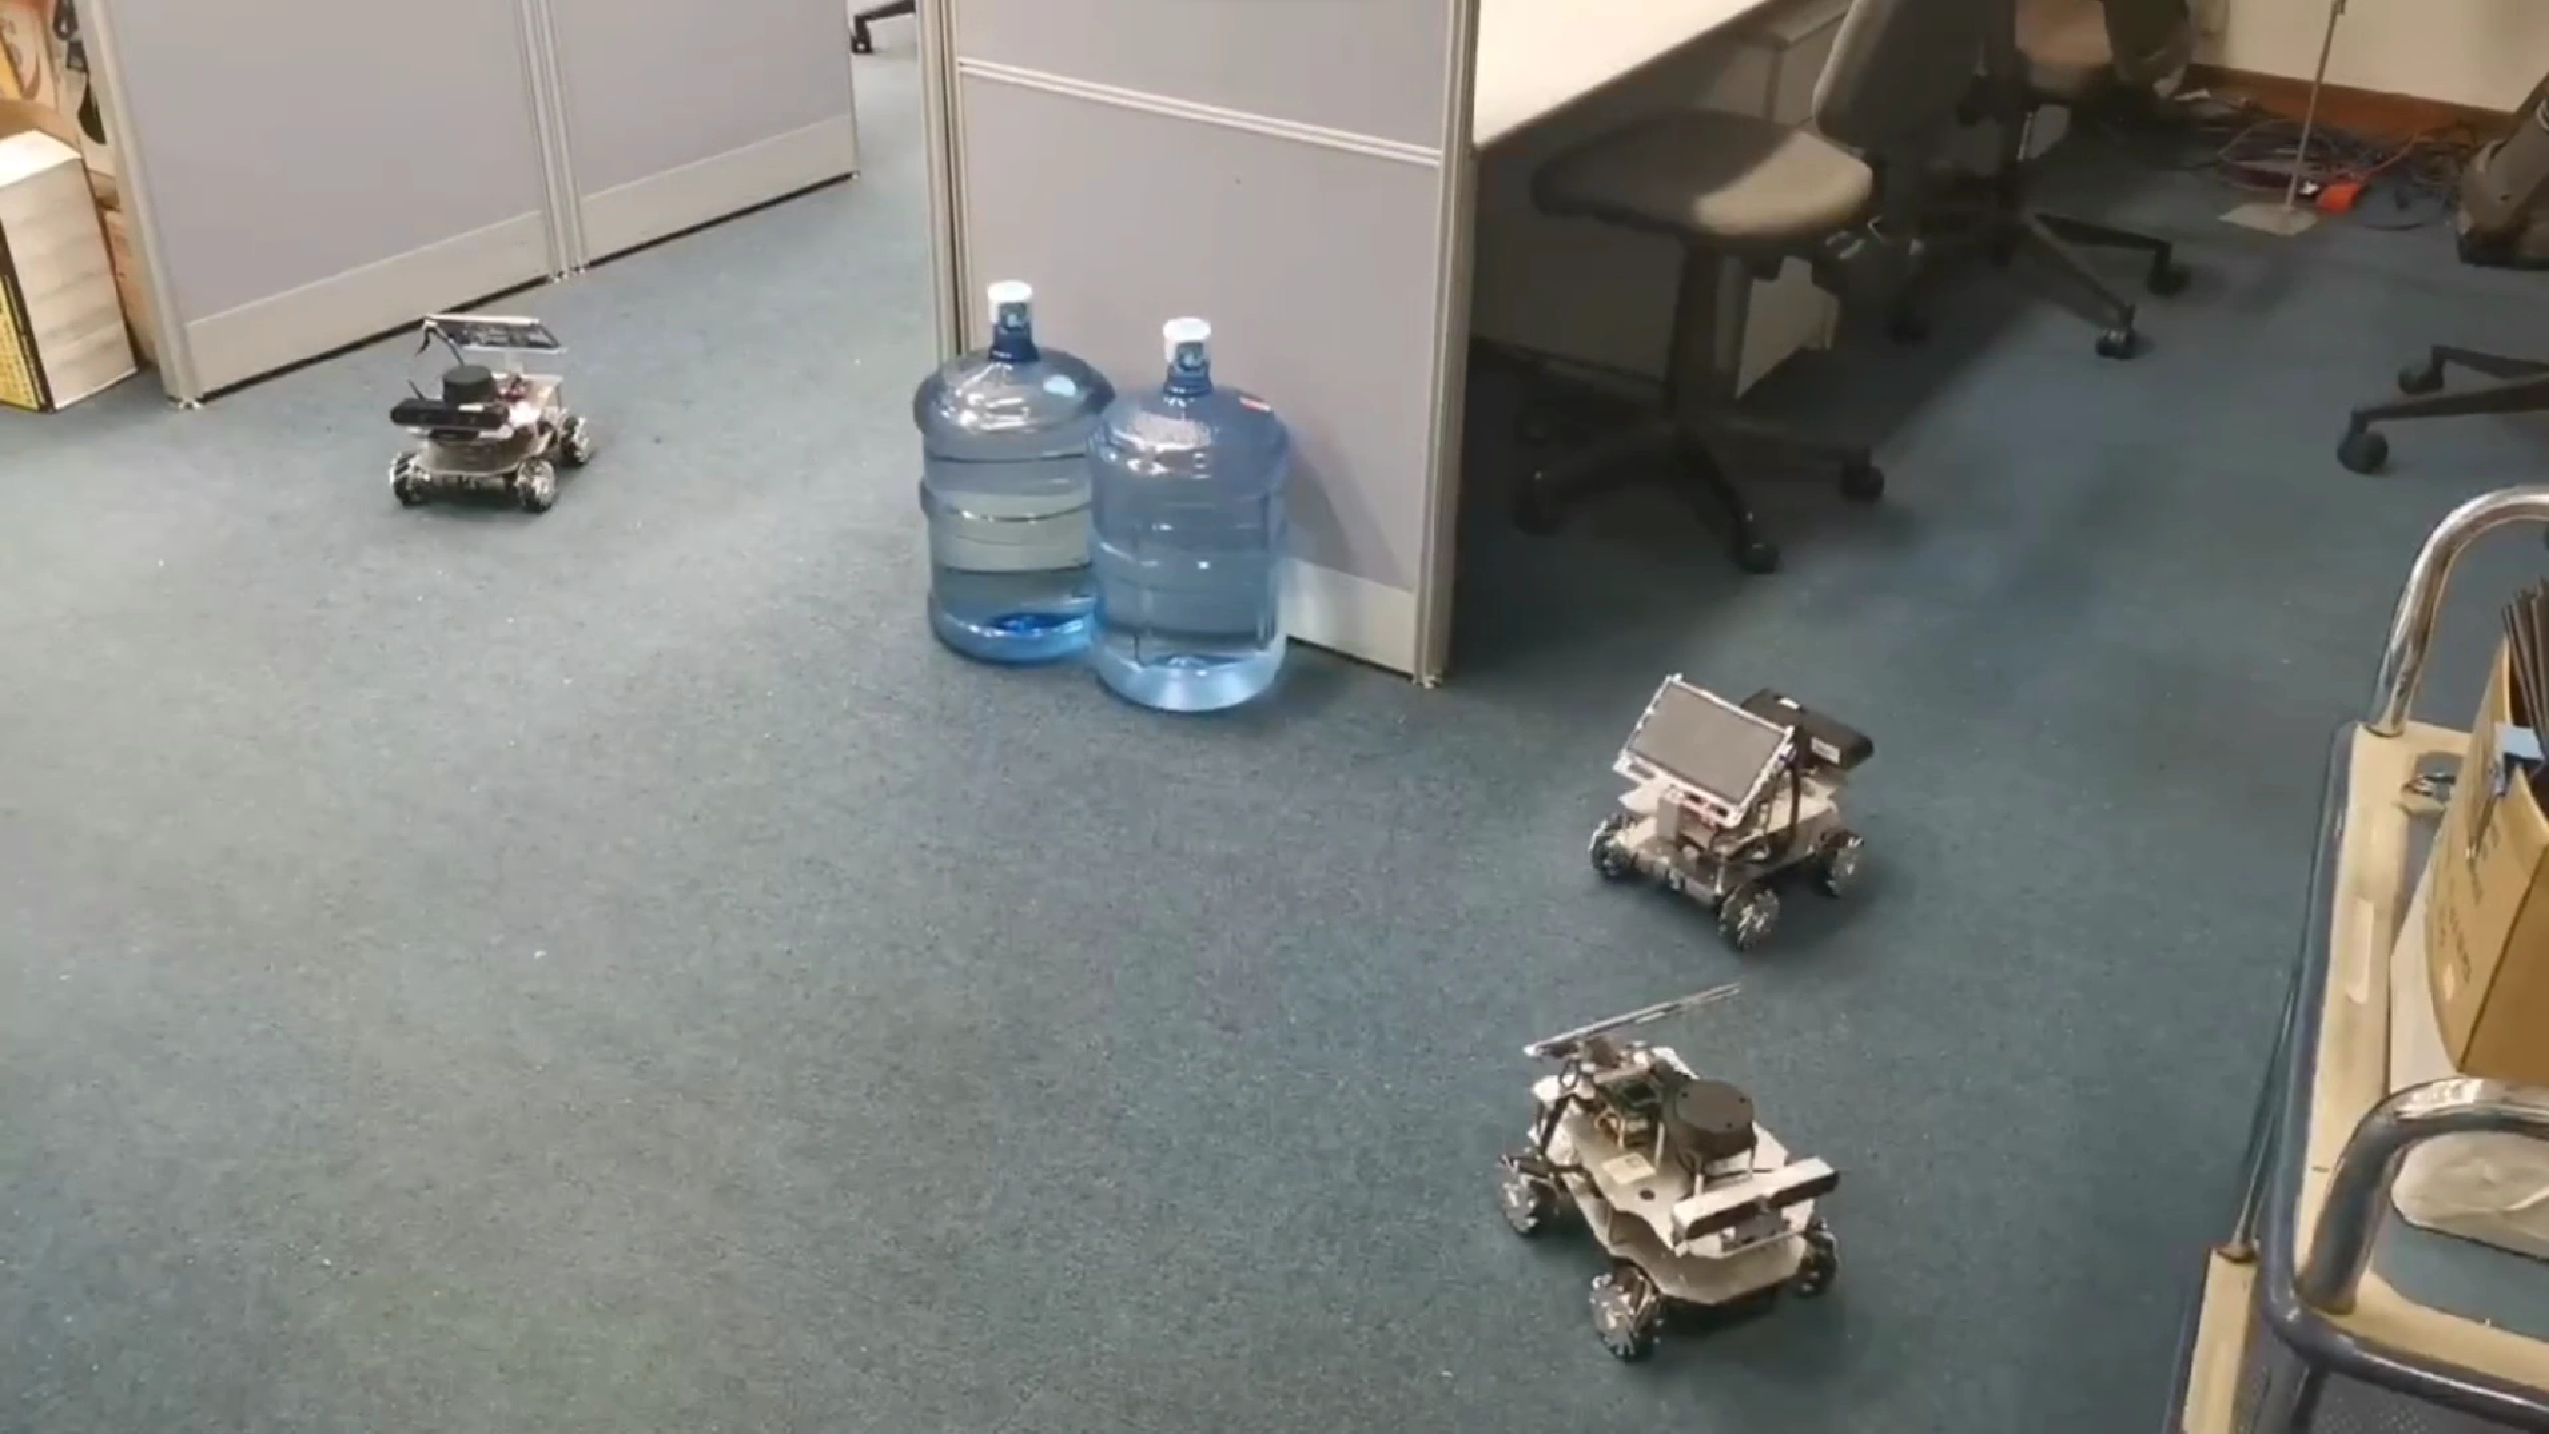
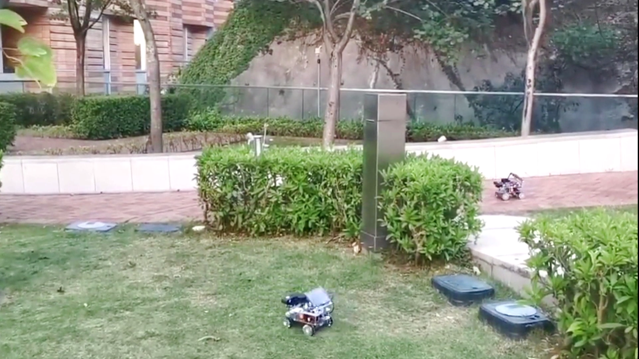
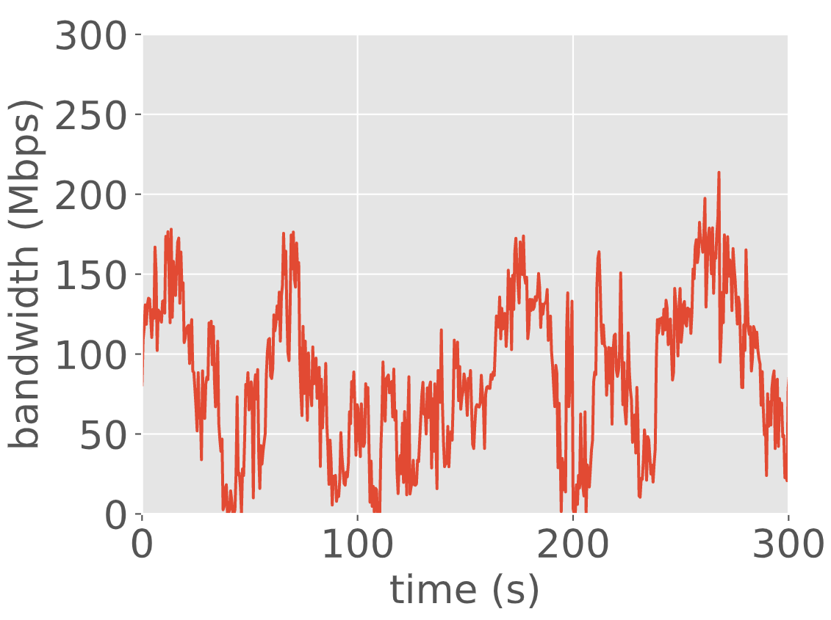
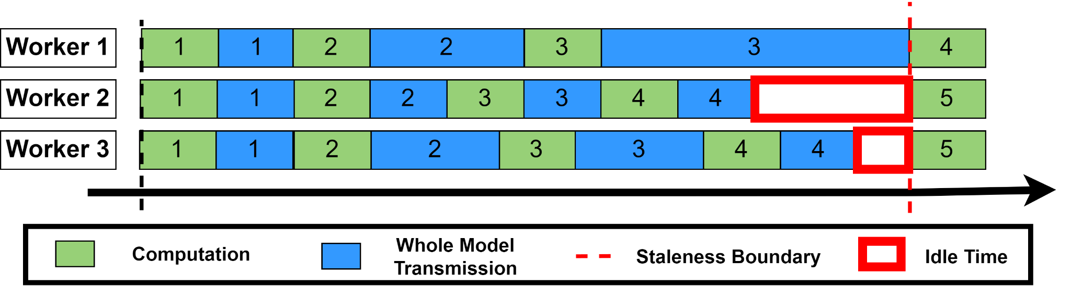
Why Existing Work Can Not Achieve 2Gs
Key reason: Their synchronization in the granularity of a whole model (model granularity) is too coarse-grained to adapt to random, frequent and sharp bandwidth fluctuation in robotic IoT.
The recorded bandwidth fluctuation in wireless networks caused by movement and obstacles
Model granularity makes imbalanced transmission time inevitable under such bandwidth fluctuation.
Indoors （office）
Outdoors (garden)
Notes:
All the above problems lead us into thinking, why existing work cannot achieve the two goals.
We show that the key reason is that their model update synchronization in the granularity of a whole model is too coarse grained to adapt to the bandwidth fluctuation in robotic IoT.
We compare the real-time fluctuating bandwidth capacity of a worker against its computation and transmission of model updates in the upper right chart.
From the chart we can see that, as the coarse-grained whole model transmission cannot fit in the fluctuating bandwidth, the worker must wait until the transmission of a whole model finishes, and it has no chance to balance its transmission time with other workers adaptively against the real-time bandwidth.
This leads to inevitable imbalanced transmission time among the workers and stall.

Slide 7
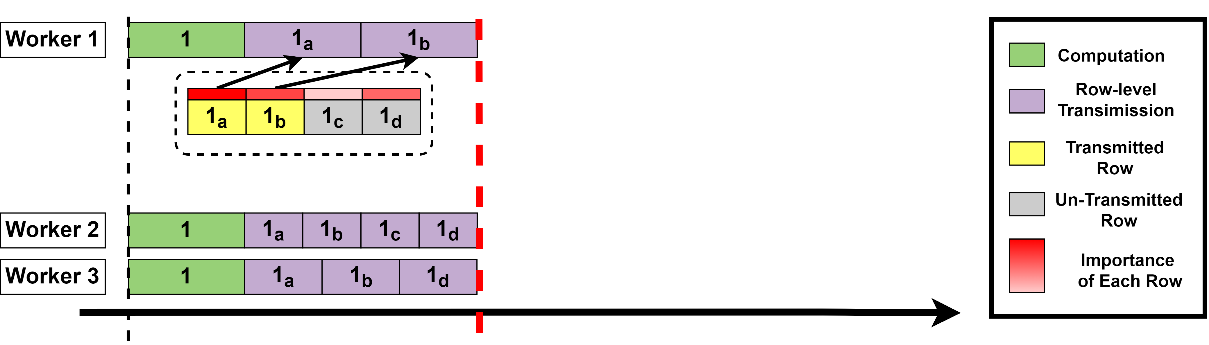
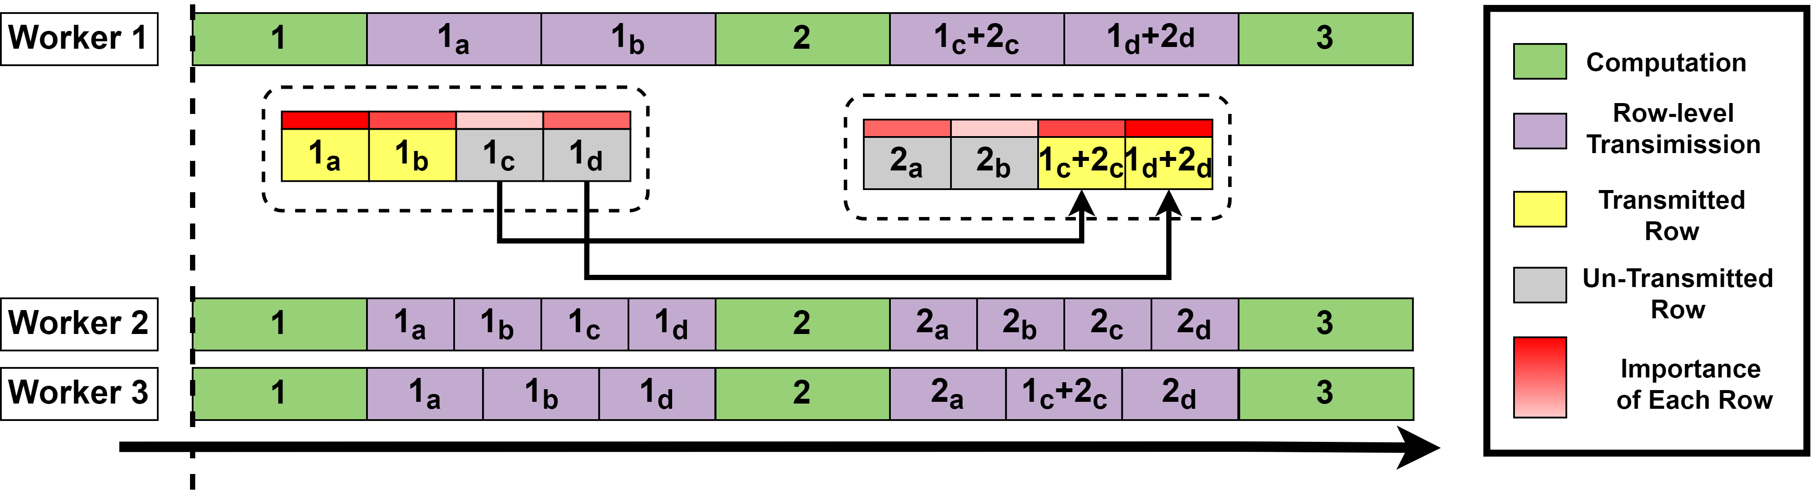
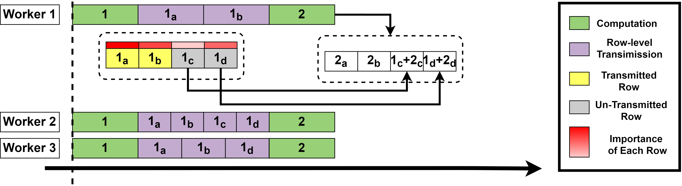
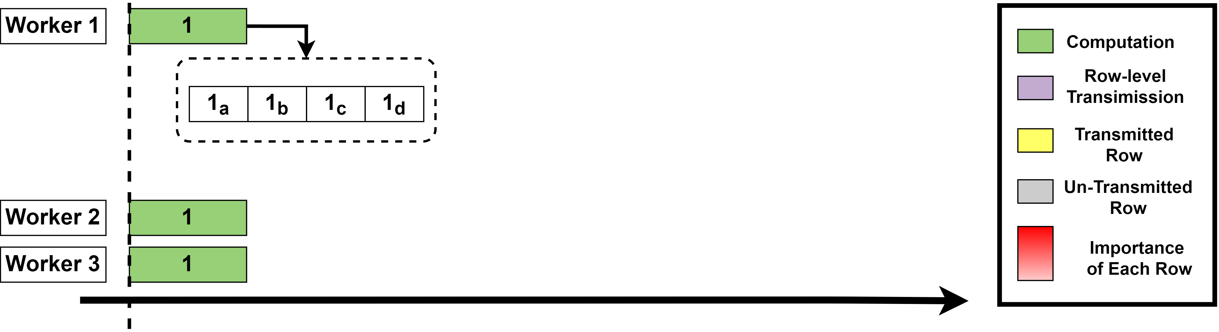
From Model Granularity to Row Granularity
We propose a new row granulated synchronization method: break up the synchronization granularity of gradients into matrix rows.
Why rows: element granularity incurs high management cost; layer granularity (matrixes) still suffers from low transmission flexibility.
Row granularity enables more flexibility in scheduling:
Adaptively adjust the transmission volume to balance transmission time
Transmit more important gradient rows first to accelerate model convergence
Model
Notes:
In a word, breaking up the model update synchronization granularity is a must, and we propose to use row granularity, which breaks up the synchronization granularity of model updates into matrix rows.
The reason of choosing rows is that synchronization in element granularity (or a single parameter in the model) requires indexing of each element, which incurs high management cost, and layer granularity is still comparable with model granularity in size and is still coarse-grained.
Row granularity best trades off between management cost and transmission flexibility.
Row granularity enables us to adaptively decide the transmission volume in each training iteration so that each worker spends roughly the same time in synchronization.
Specifically, as the graph shows, workers choose the number of rows to be transmitted in a training iteration to balance transmission time
and gradients of the un-transmitted rows will be accumulated with gradients computed in the following training iterations, so that no gradients will be lost.
Row granularity also enables us to select important rows with higher contribution (such as rows marked yellow in the graph) and transmit them first to accelerate model convergence.

Slide 8
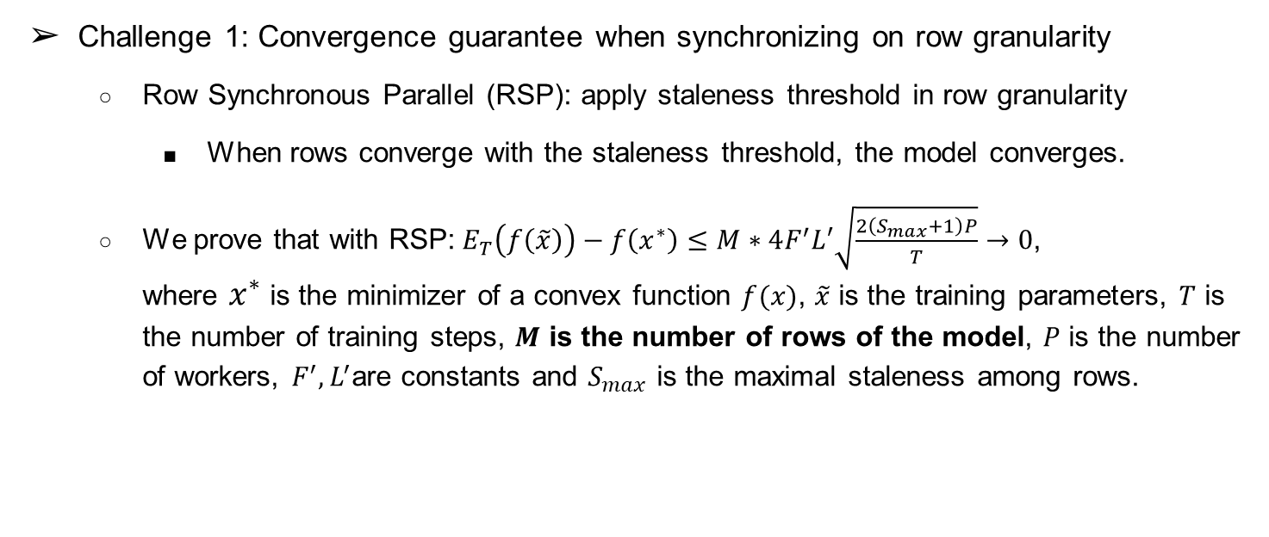
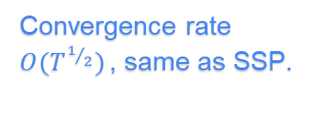
ROG: ROw-Granulated, High Performance and Robust
Challenge 1: Convergence guarantee when synchronizing on row granularity
Row Synchronous Parallel (RSP): apply staleness threshold in row granularity
When rows converge with the staleness threshold, the model converges.
We prove that with RSP:${ E}_{T}\left(f\left(\tilde{x}\right)\right)−f\left(x^{∗}\right)≤M∗4F^{′}L′\sqrt{\frac{2\left(S_{max}+1\right)P}{T}}→0$, where $x^{∗}$is the minimizer of a convex function $f(x)$, $\tilde{x}$ is the training parameters, $T$ is the number of training steps, $M$ is the number of rows of the model, $P$ is the number of workers, $F^{′},L^{′}$are constants and $S_{max}$ is the maximal staleness among rows.
Convergence of rows
Convergence rate $O(T^{1/2})$, same as SSP.
Notes:
Leveraging the above idea, we propose ROG, a ROw-Granulated, high performance and robust distributed training system optimized for real-world robotic IoT networks.
Still, the design of ROG needs to tackle the following challenges.
The first challenge is how to guarantee the convergence of the training model, when synchronizing model updates among robots in row granularity?
We propose Row Synchronous Parallel that applies staleness threshold in row granularity, which is based on the intuition that the threshold bounds staleness of rows across workers in RSP and guarantees convergence of rows, just like the threshold bounds the staleness of model updates in SSP; when all rows converge, the model also converges.
In our paper, we prove the convergence of rows under RSP and finally the convergence of the whole model.
Notably, the design of RSP achieves the same convergence rate as SSP.

Slide 9

ROG: ROw-Granulated, High Performance and Robust
Challenge 2: How to schedule the transmission of rows to achieve 2Gs？
Adaptive Transmission Protocol (ATP) to balance transmission time (G1):
Select a transmission time.
During this transmission time: non-straggler transmit rows at best effort; stragglers transmit a minimal number of rows.
Balance transmission time among non-stragglers.
Stragglers fall behind slower and catch up quicker.
Only stall when certain rows trigger the staleness threshold.
Transmit gradient rows with more contribution to training accuracy first (G2).
Notes:
The second challenge is how to schedule the transmission of rows to achieve the two goals.
Leveraging row granularity, we propose a passive protocol named Adaptive Transmission Protocol to balance transmission time among workers for high training throughput.
In each training iteration, we select a transmission time
and non-stragglers will transmit gradient rows at best effort within the transmission time. Just like the idea of Be Water~, rows will be transmitted whenever there is still time left while the transmission time is balanced.
Stragglers are allowed to transmit a minimal number of rows so that they can fall behind slower and also catch up quicker.
Workers will only stall when certain rows trigger the staleness threshold.
As for statistical efficiency, we sort the gradient rows based on their contribution as discussed before and transmit those with higher contribution first to accelerate convergence.

Slide 10
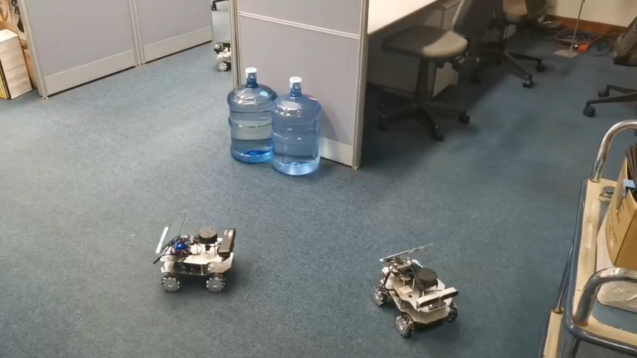

Implementation and Evaluation
Implementation Details:
Implemented as a PyTorch optimizer, easy to use and extensible to any imperative Deep Learning frameworks.
Baseline Distributed Training System: BSP, SSP with high staleness threshold (SSP 20), SSP with low staleness threshold (SSP 4), FLOWN.
Evaluation settings
Real-world robots: four-wheel robots with NVIDIA Jetson Xavier NX
Networks: mesh networks based on 802.11ac
Cooperative online learning robotic applications: 1. domain adaptation; 2. implicit mapping
Real-world wireless networks and environments: indoors (laboratory with desks and separators); outdoors (campus garden with trees and bushes).
Minimize the communication volume with gradient compression.
Indoor
Outdoor
Notes:
We implemented ROG as an easy to use pytorch optimizer and it is extensible to any imperative deep learning frameworks.
We evaluated ROG against the baselines such as SSP and FLOWN on real world four wheel robots equipped with high end NVIDIA Jetson Chips optimized for AI computing.
We formed the robotic IoT networks by building a mesh network among the robots based on WiFi5.
The evaluated applications include domain adaptation and implicit mapping that require real-time training of the machine learning models.
We selected two representative environments for the robotic tasks, which is indoors in our laboratory with desks and separators and outdoors in our campus garden with trees and bushes.

Slide 11
Evaluation Questions
How does ROG benefit real-world robotic applications in terms of training accuracy and power consumption?
How does ROG handle the instability of wireless networks?
How sensitive is ROG to different batch sizes, different numbers of devices, and different thresholds?
What are the limitations and potentials of ROG?
Notes:
In this talk, we focus on the questions of, first, end-to-end training accuracy and power consumption gain of ROG and, second, the microevents of ROG handling the instability of wireless networks.
For the rest of the questions, please refer to our paper.

Slide 12
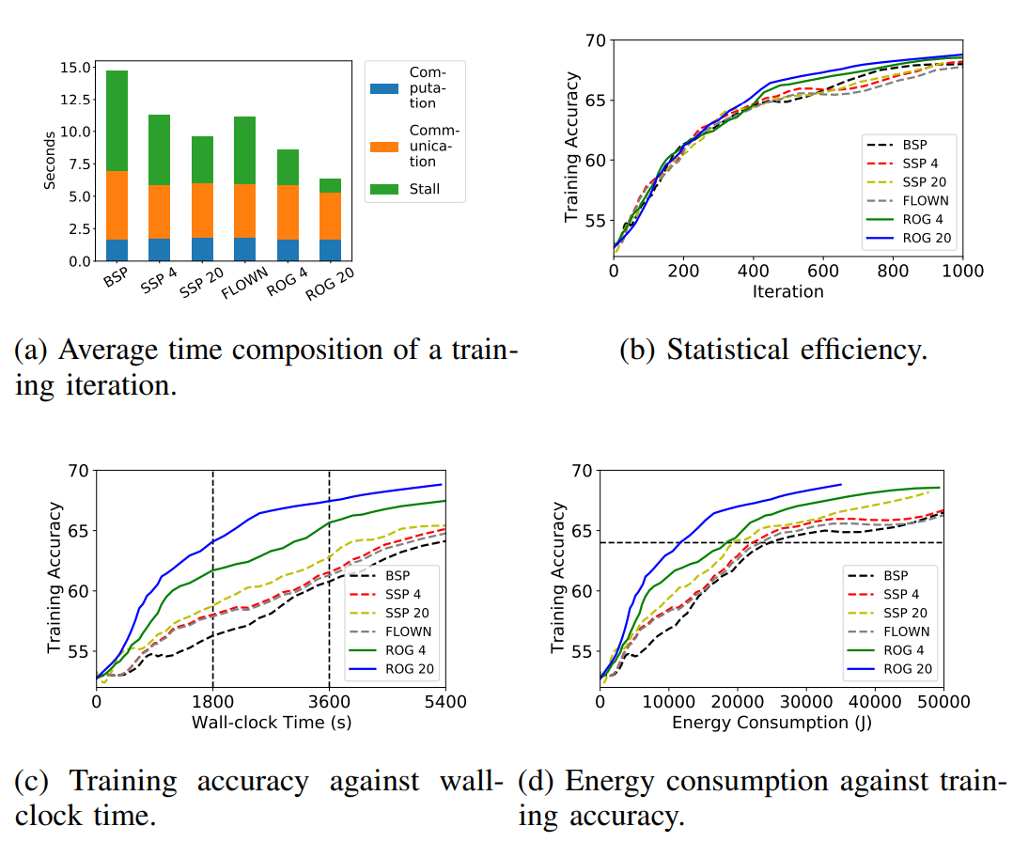

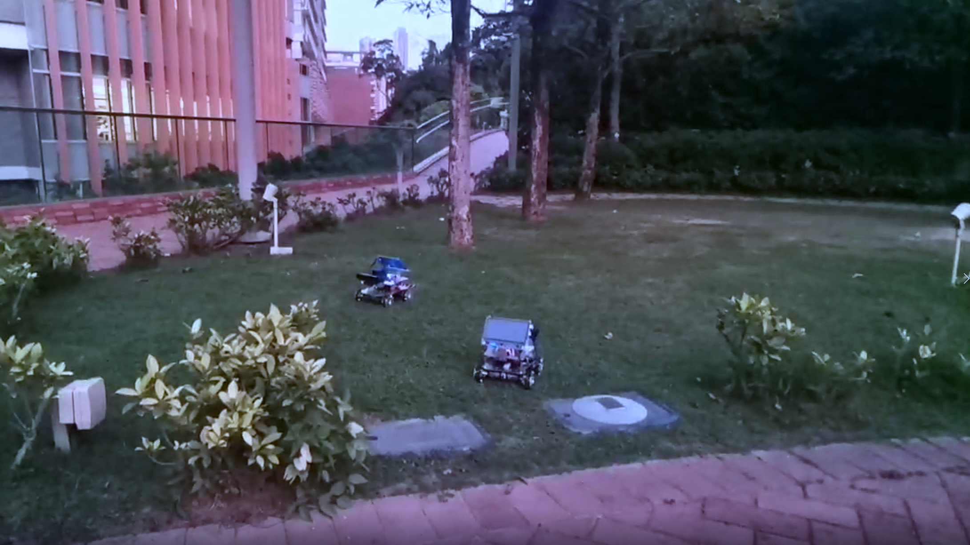
End-to-End Performance
ROG achieves high training accuracy. ROG achieved a 4.9%~6.5% accuracy gain over the baselines after training for 60 minutes.
ROG is energy-efficient. When the training model reached a same high accuracy, compared with the baselines, ROG reduced battery energy consumption by 20.4%~50.7%.
ROG achieved the above gain because during the training for 60 minutes, ROG achieved:
High training throughput (25.2%~80.4% higher than baselines, G1)
Non-degraded statistical efficiency (G2)
Domain
Adaptation
Source Image
Target Image
Domain Adaptation in Outdoors Scenario
Notes:
Evaluation on end-to-end performance shows that ROG achieves high training accuracy. After training in the domain adaptation task in outdoors for 60 minutes, ROG achieved 4.9 % to 6.5 % higher accuracy compared with the baselines.
ROG is also energy-efficient. To reach the same high training accuracy, ROG reduced battery energy consumption by 20.4% to 50.7% compared with the baselines.
These advantages were achieved by fulfilling the two Goals: 25.2% to 80.4% higher training throughput by reducing stall as shown in the average time composition of a training iteration, and non-degraded statistical efficiency.

Slide 13
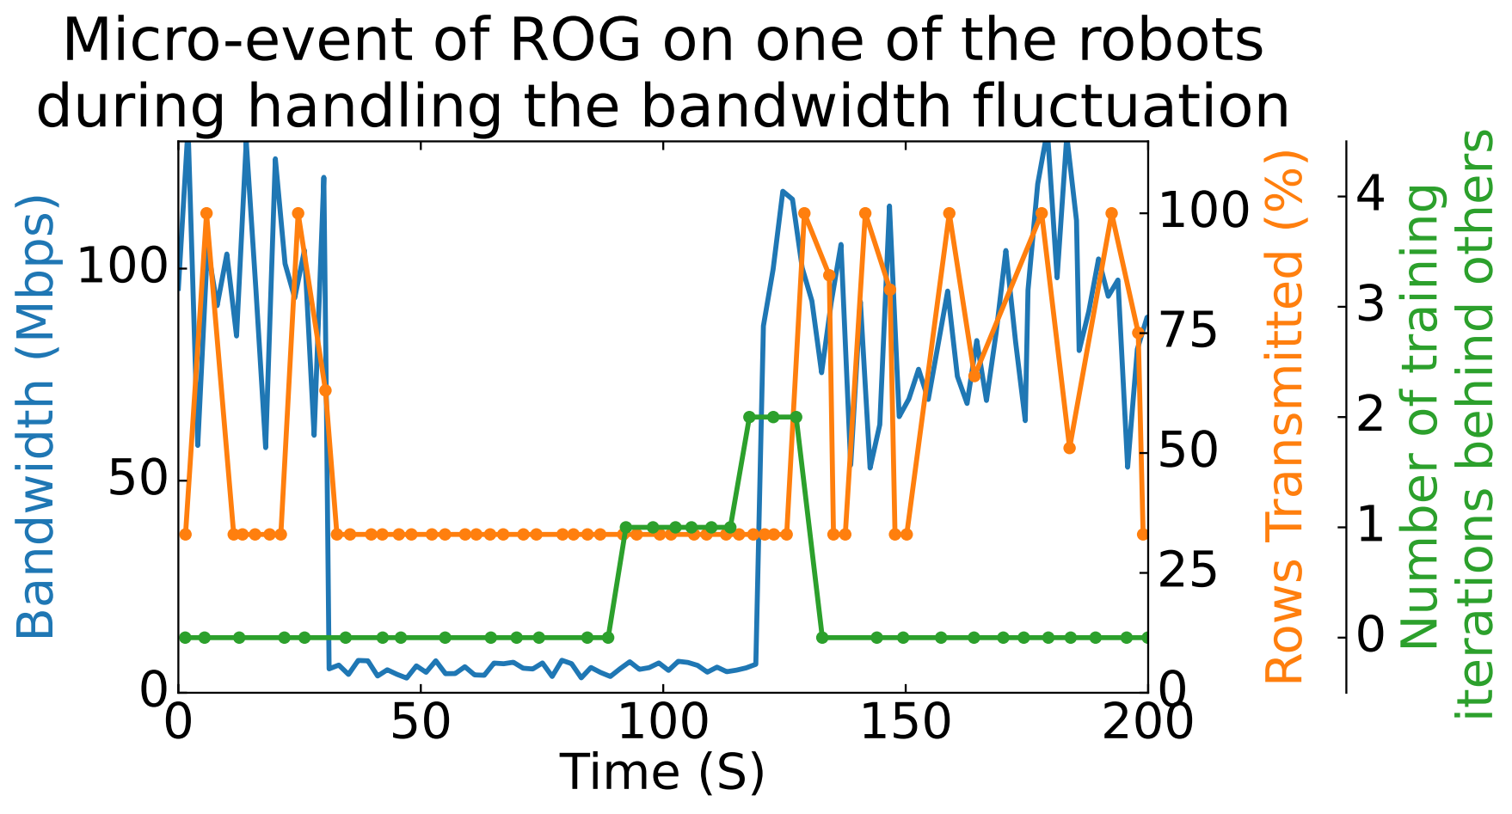

Microevents: How ROG Handles the Straggler Effect
① Bandwidth fluctuating: ROG adaptively adjusts the number of rows to be transmitted to avoid this robot from falling behind.
② Bandwidth degrades: this robot becomes a straggler and is required to transmit the minimal number of rows to lower the speed of falling behind.
①
②
③
③ Bandwidth rises: this robot quickly catches up with others because it is allowed to transmit fewer number of rows than other robots.
Notes:
Next, we show the microevents of ROG handling the straggler effect.
When the bandwidth marked as the blue line is fluctuating in the first stage, the number of rows transmitted by this worker (marked as the yellow line) is adaptively adjusted under ATP and staleness (marked as the green line) is controlled at a low level.
When the bandwidth encounters sharp degradation for a long time, the worker inevitably becomes a straggler, but it can transmit the minimal number of rows and slow down the speed of increase of staleness.
When the bandwidth recovers, this worker quickly catches up with others and staleness decreases since it is allowed to transmit fewer rows than other non-stragglers.
In this way, the chances of causing stalls due to straggler effect is minimized because the staleness of rows is minimized.

Slide 14

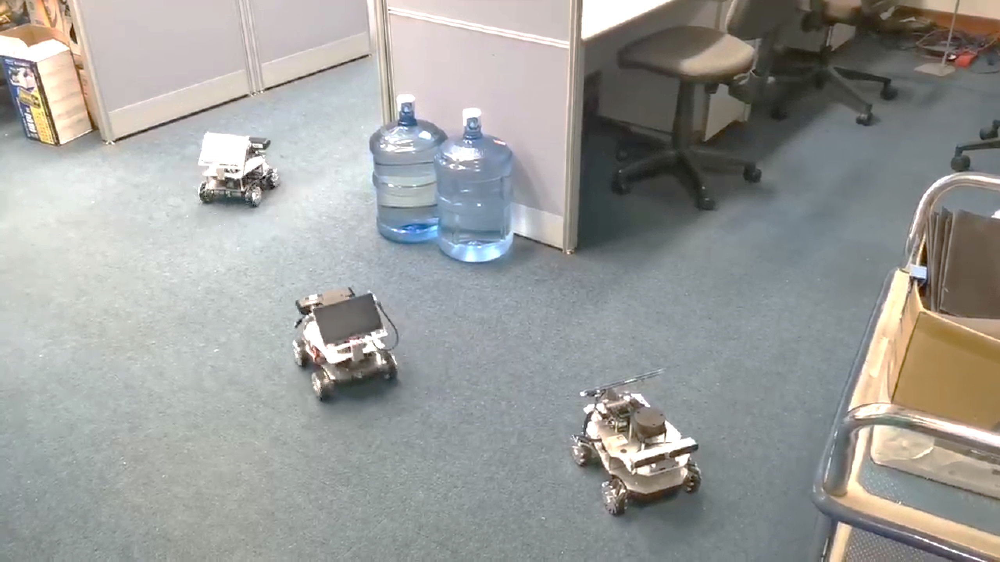
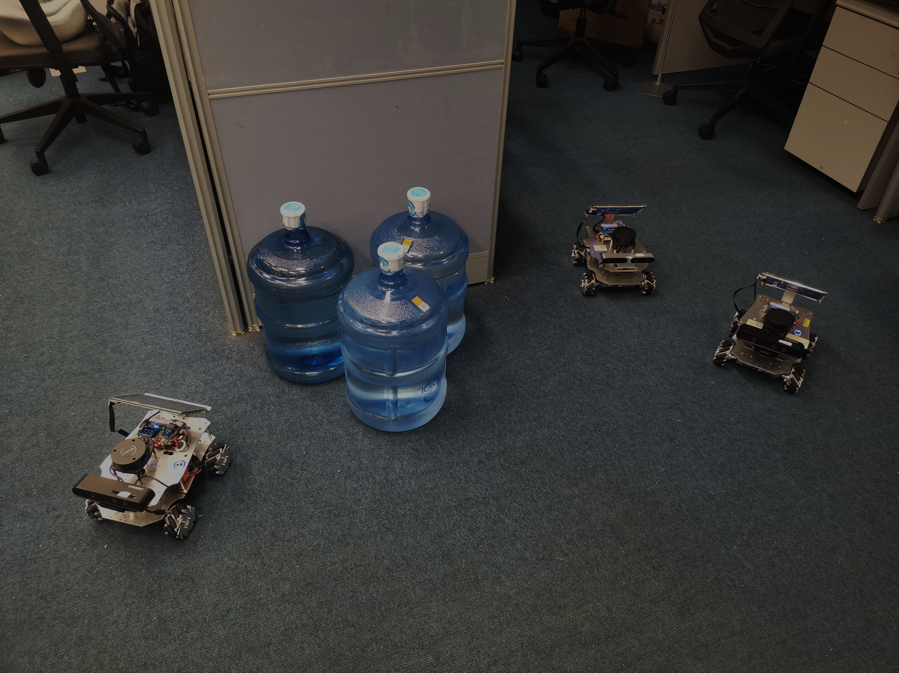
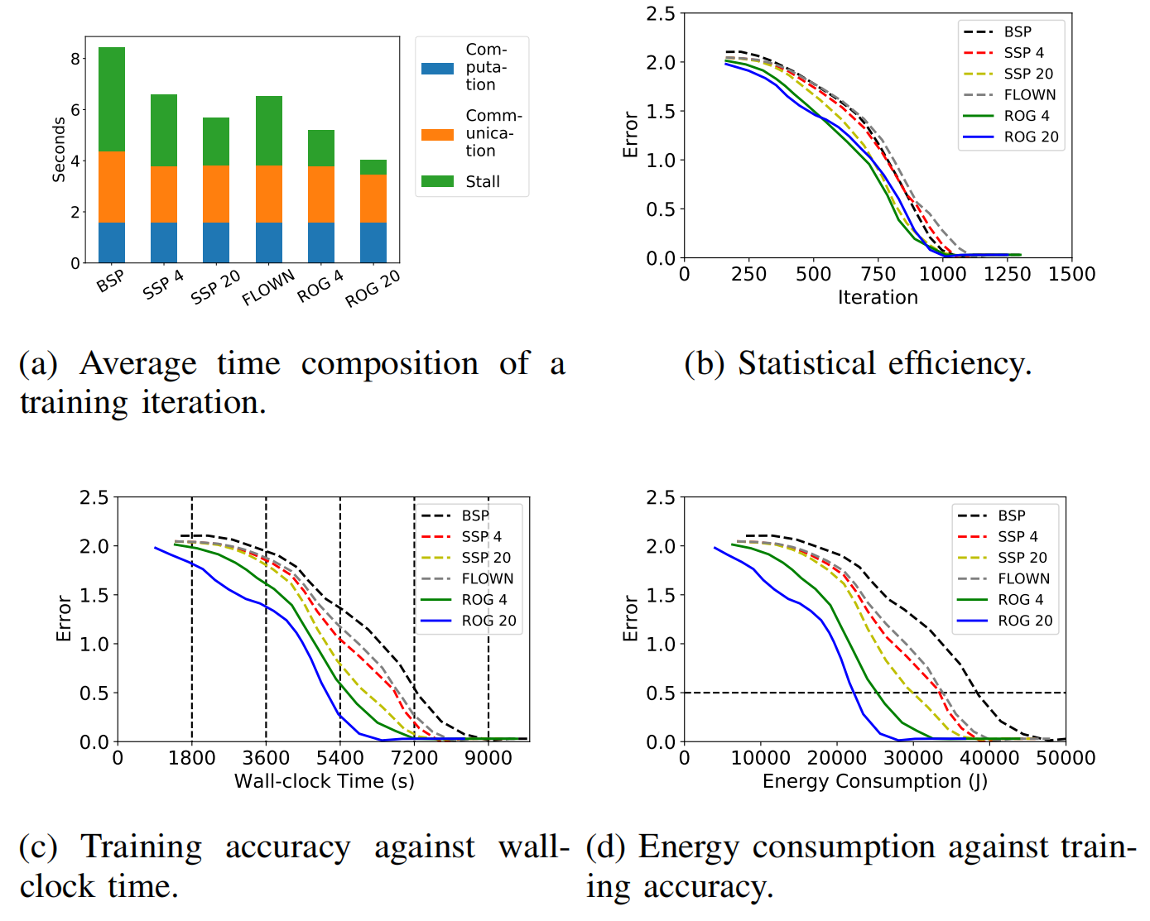
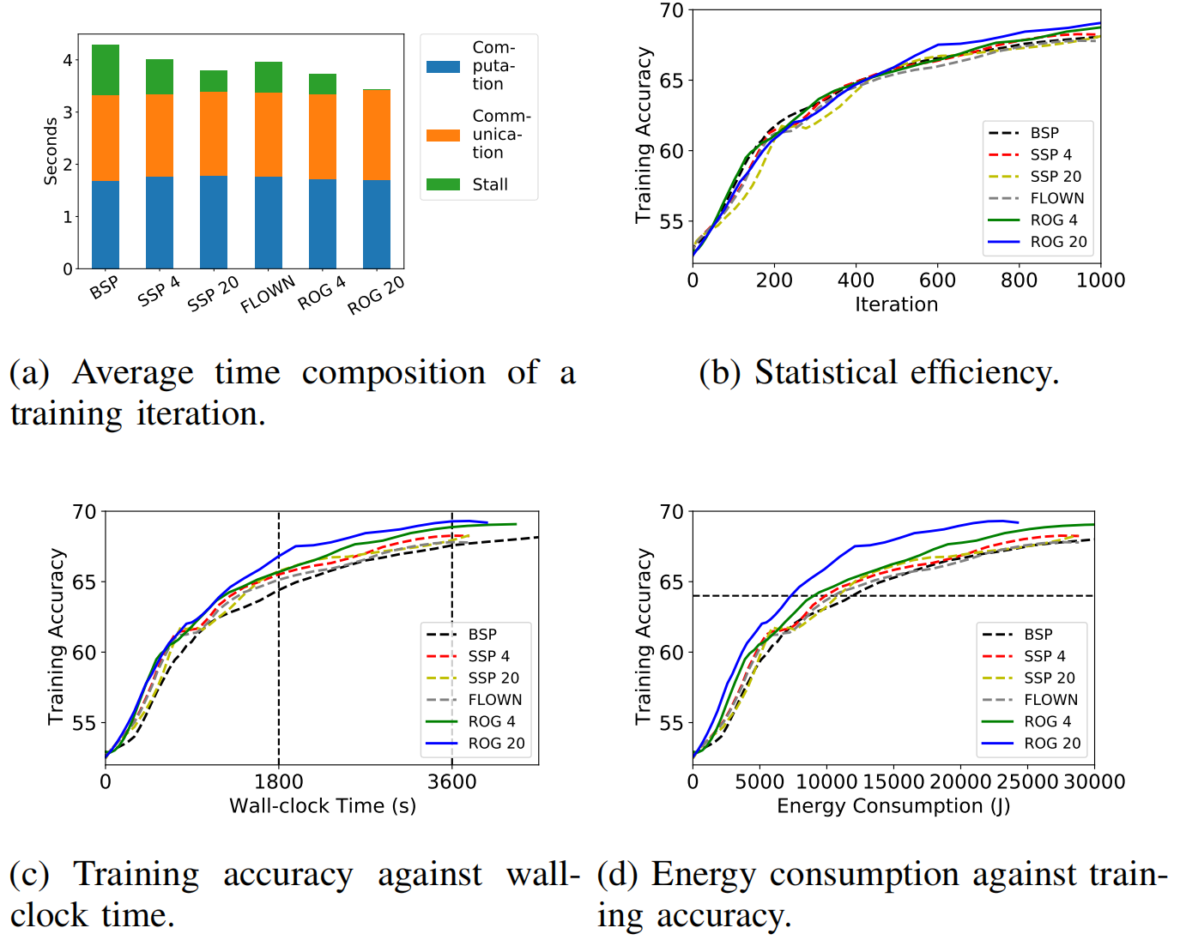
ROG’s Performance on Various Applications and Environments
Implicit Mapping in Indoor Scenario
Domain Adaptation in Indoor Scenario
Domain
Adaptation
Source Image
Target Image
For various real-world online learning robotic applications and real-world environments, ROG’s advantages in high training accuracy and low energy consumption remain.
Notes:
Here are the results of ROG in other environment and other application, including the reduction of error when building the implicit map with online training and training accuracy of domain adaptation in indoor scenario.
For the various online training applications and environments, ROG’s advantages of high training accuracy and low energy consumption remain

Slide 15
Conclusion
In this talk, we presented ROG, a ROw-Granulated distributed training system optimized for robotic IoT networks.
ROG breaks up the granularity of model synchronization into rows and applies adaptive scheduling to the transmission of each row, fulfilling 2Gs.
ROG is easy to use. It took only tens of lines of code to apply ROG to existing ML applications.
By better trading off 2 goals for bandwidth fluctuation in wireless networks, ROG will nurture diverse ML applications deployed on mobile robots in the field.
ROG’s future work:
Integrate ROG with existing methods for accelerating distributed training such as pipelining communication and computation (Pipe-SGD [NIPS ‘18]).
ROG’s artifact is available at https://github.com/hku-systems/ROG
Notes:
In conclusion, we presented ROG, a ROw-Granulated distributed training system optimized for robotic IoT networks.
It breaks up the granularity of model synchronization into rows and applies adaptive scheduling to the transmission of each row.
By better trading off between high training throughput and high statistical efficiency under the bandwidth fluctuation in wireless networks, ROG will nurture diverse ML applications deployed on mobile robots in the field and it has broad future work.
Thanks a lot for your attention and any questions are welcome.

Slide 16
Future work on Robotic IoT
Limitation of computation resource on robot
Offload GPU computation to cloud or edge device
Scheduler for distributed training
robot-motion aware and environment aware
Different number of workers
Active Multi-robot cooperative
mapping quality aware and multiview cooperation
…

